Slide 1

Project Demo (A Bee)
Abhi Trivedi, Samuel Meyerding, Conor Van Achte

Slide 2
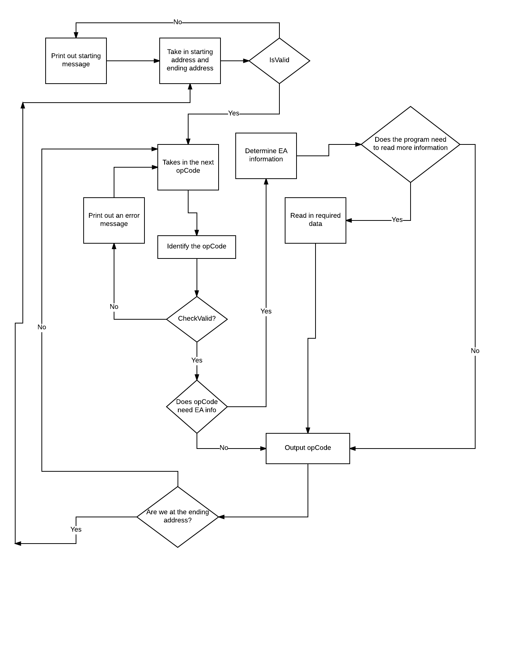

Slide 3
List of OpCodes completed
MOVE
MOVEA
ADDI
BTST
NOP
RTS
LEA
CLR
JSR
MOVEM
ADDQ
MOVEQ
ROL
All conditional branches (Bcc)
DIVU
OR
SUB
CMP
CMPA
ADD
ADDA
MULUS
AND
LSL
LSR
ASL
ASR

Slide 4
EA Completion
All of the associated EA works for each of these opcodes
MOVE
MOVEA
ADDI
BTST
NOP
RTS
LEA
CLR
JSR
MOVEM
ADDQ
MOVEQ
ROL
JMP
All conditional branches (Bcc)
DIVU
OR
SUB
CMP
CMPA
ADD
ADDA
MULUS
AND
LSL
LSR
ASL
ASR

Slide 5
IO Completion:
Welcome message
Prompt the user for Starting location and Ending location
Convert the entered location into Hexadecimal format
The output shows one screen of data at a time
Hitting the Enter key displays the next screen of information
Also prints out the error message as 1000 DATA $WXYZ
Print the data in the following order:
a-Memory location b-OpCode c-Operand
Prompts the user to disassemble another memory image

Slide 6
Problems
Integration
Time Schedule
Testing

Slide 7
Demo of Disassembler:

